Slide 1
Deep learning frameworks

Slide 2
Deep learning frameworks
What are they?
TensorFlow (TF Lite, TF js)
Keras
PyTorch
Sonnet
Darknet
How to use?

Slide 3
What are they?
Deep learning frameworks are something that grant us implemented “building” blocks for designing, building, training and validating deep neural networks via high-level interface.
*Reminder: every neural network that has more than 1 hidden layer is considered deep.

Slide 4
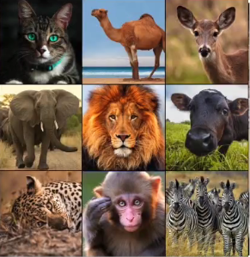
Ok. Say we have a task to classify images

Slide 5
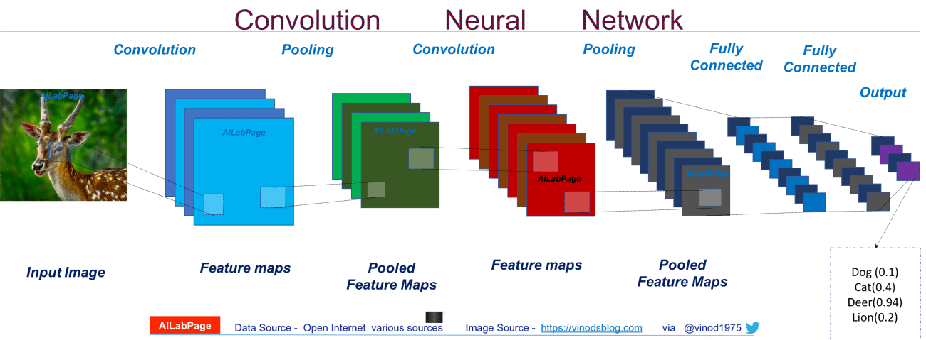
How? Convolutional NN!

Slide 6
What about implementation?

Slide 7

What about implementation?

Slide 8

What about implementation?

Slide 9

What about implementation?

Slide 10

What about implementation?

Slide 11

What about implementation?

Slide 12

What about implementation?

Slide 13
What about implementation?

Slide 14

Deep learning frameworks!

Slide 15
Let’s have some brief reviews of main frameworks, then deepen into using them

Slide 16

Tensorflow
An open source artificial intelligence library, using data flow graphs to build models. It allows developers to create large-scale neural networks with many layers.
+
—
Open-source platform
Data visualization
Keras friendly
Compatible
Parallelism
Architectural support (TPU)
Graphical support
Frequent updates
Bad documentation
2. Inconsistent
3. Dependency
4. GPU Support
5. Slow speed
6. Support for Windows

Slide 17

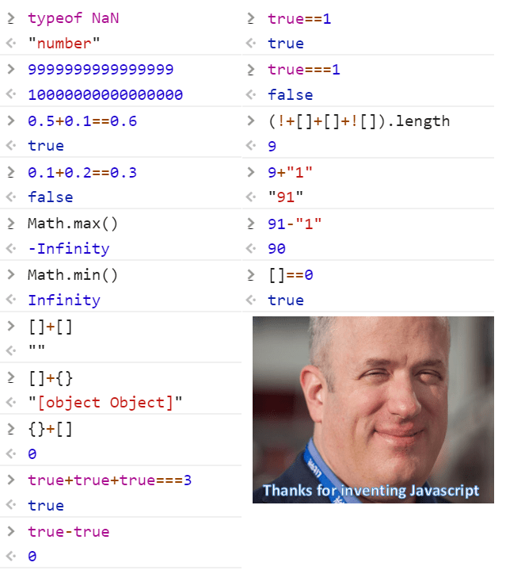
TF js
TensorFlow.js is a library for machine learning in JavaScript. You can develop ML models in JavaScript, and use ML directly in the browser or in Node.js.
https://www.tensorflow.org/js - a nice link to check it out

Slide 18

TF light
Lightweight: Provides fast initialization and launch of small machine learning models on mobile devices.
Cross-platform: training models on a large number of mobile platforms, including Android and iOS
Speed: the library is optimized for use on mobile devices, supports hardware acceleration.
https://www.tensorflow.org/lite - a nice link to check it out

Slide 19

Keras
An open-source deep learning environment, written on Python. Made by an engineer from Google, Francois Chollet, presented in March, 2015. It’s target is operational working with neural networks, it’s compact, modular, expandable. It’s library – can’t live on it’s own. Tensorflow add-on.
+
—
Convenient to use.
Easy to learn.
Fast-paced.
Good documentation.
Built in TF.
Does not fit for big projects
Not thread-safe
Troubles with distributed training
Bad customization
Only Python support

Slide 20

PyTorch
An open source machine learning framework for Python built on top of Torch. It is used to solve various problems: computer vision, natural language processing. Developed primarily by the Facebook artificial intelligence group.
+
—
Easy to use
Developer friendly
Easy to debug
Sometimes faster than TF
Data parallelism
Cloud support
Lack of visualization
Not yet widely known and used (but already compared with TF)
Lacks model serving in production

Slide 21
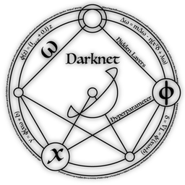

Darknet
An open source framework written in C using the CUDA hardware / software parallel computing architecture. It's fast, lightweight and easy to use. Darknet also supports CPU and GPU computing.
+
—
Simple
Fast
Convinient
Mystic website
Not used anywhere but in detection tasks
Not recommended for big projects
Bad documentation
Mystic website

Slide 22




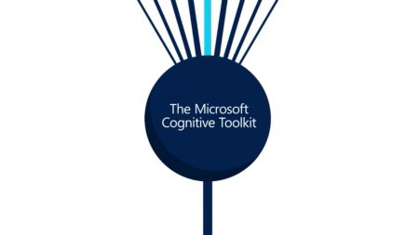

Slide 23

What framework should I use?

Slide 24
What framework should I use? Some recommendations for different cases
TensorFlow is good for advanced projects like building deep neural networks. It can be used to recognize speech, faces, objects and images, as well as to work with text.
PyTorch is suitable when you need to train models quickly and efficiently. Convenient for rapid prototyping in research, as well as for small projects.
Keras is suitable for rapid prototyping. Good in cases related to translation, image and speech recognition.
Darknet is suitable for small projects. Works well for detection tasks.

Slide 25
Caffe – fast as f…lash
MXNet - Highly efficient, scalable for many machines
ONNX – easy to switch platforms, flexible
- stands for Java
CNTK - easy training and combination of model types across servers
Fit for image, handwriting and speech recognition use cases

Slide 26
Ok! Time for some code examples.

Slide 27
Keras
There is one nice and simple example of setting up a network. The task is diagnosing the risk of diabetes mellitus based on the patient's condition – binary classification. The features are:
Number of pregnancies (all patients from the source are women of at least 21 years of age, Indian Pima).
Plasma glucose concentration 2 hours after administration in the oral glucose tolerance test.
Diastolic blood pressure (mm Hg).
The thickness of the skin fold in the triceps region (mm).
Serum insulin concentration (μU / ml).
Body mass index (weight in kg / (height in m) ^ 2).
A function that describes the genetic predisposition to diabetes (in diabetic patients).
Age (years).

Slide 28
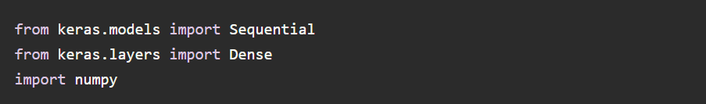

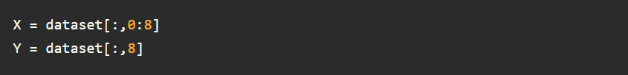
Keras

Slide 29
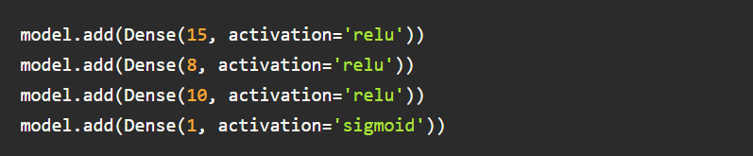
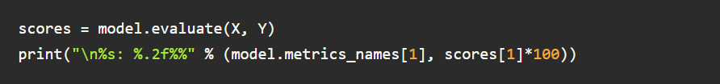
Keras

Slide 30
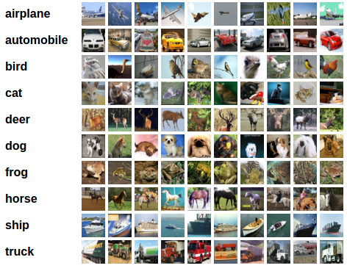
PyTorch
Let’s see a multiple classification task. We’ll have to deal with images and use CIFAR10 dataset.

Slide 31
PyTorch
We will do the following steps in order:
1. Load and normalize the CIFAR10 training and test datasets using torchvision
2. Define a Convolutional Neural Network
3. Define a loss function
4. Train the network on the training data
5. Test the network on the test data

Slide 32
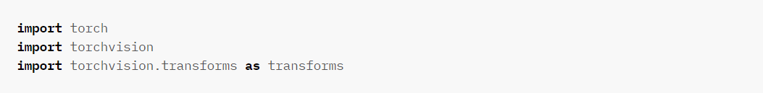
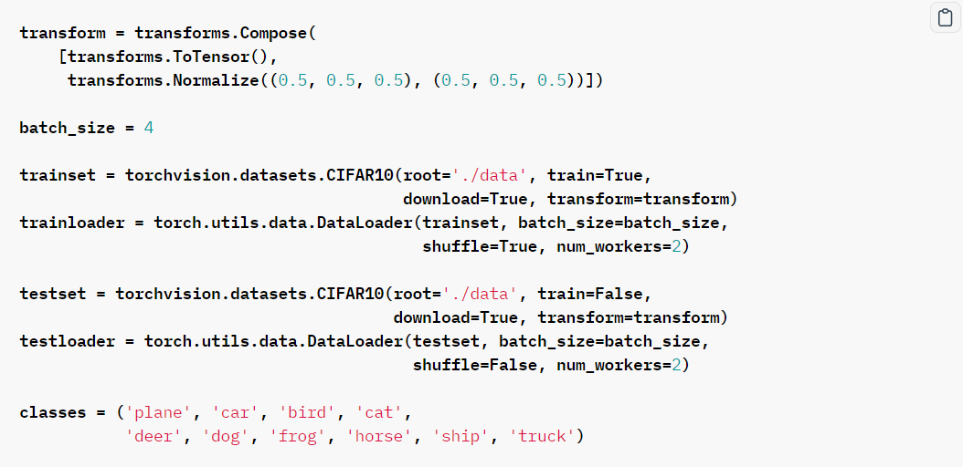
PyTorch

Slide 33
PyTorch

Slide 34
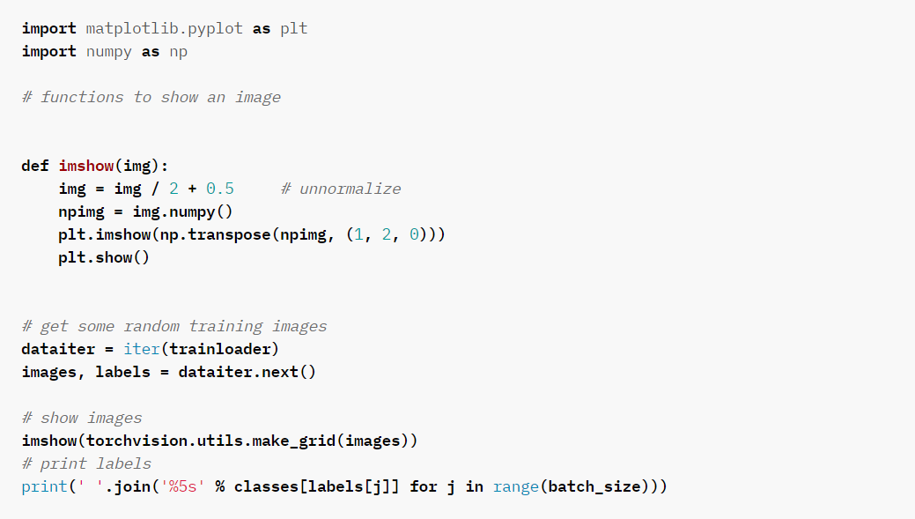
PyTorch

Slide 35
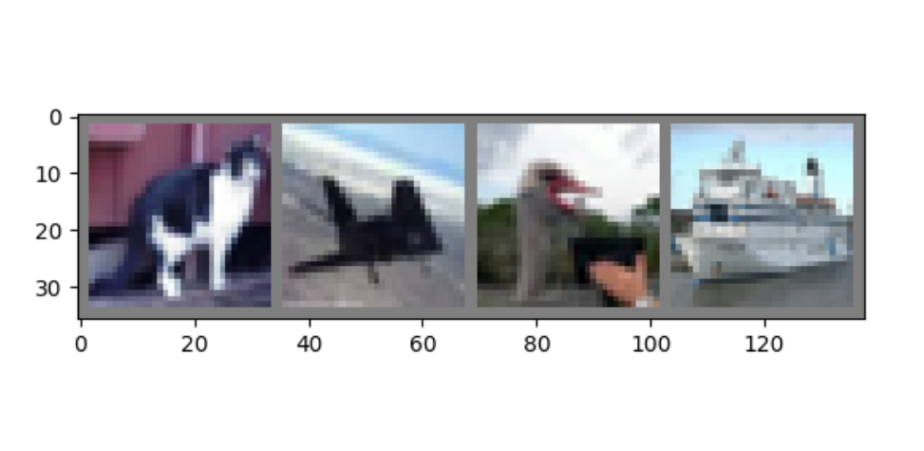
PyTorch

Slide 36
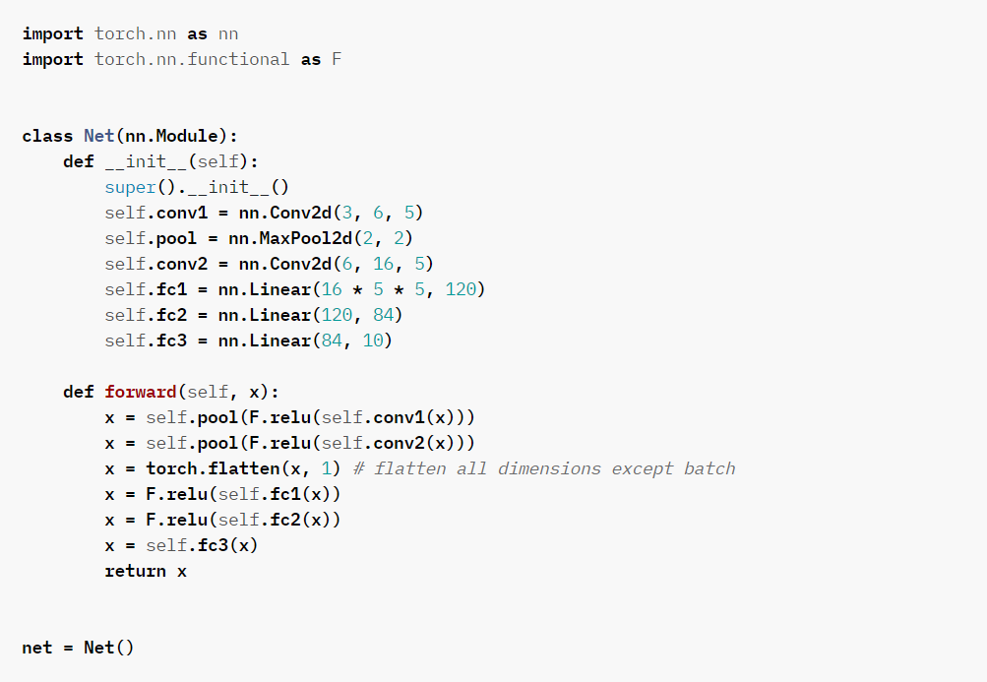
PyTorch

Slide 37
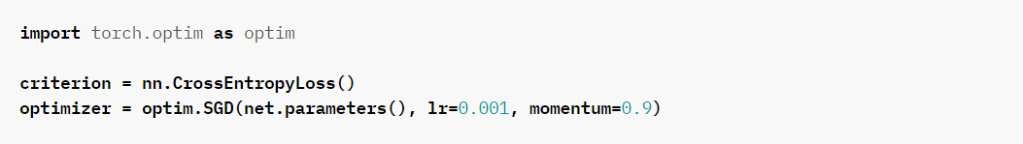
PyTorch

Slide 38
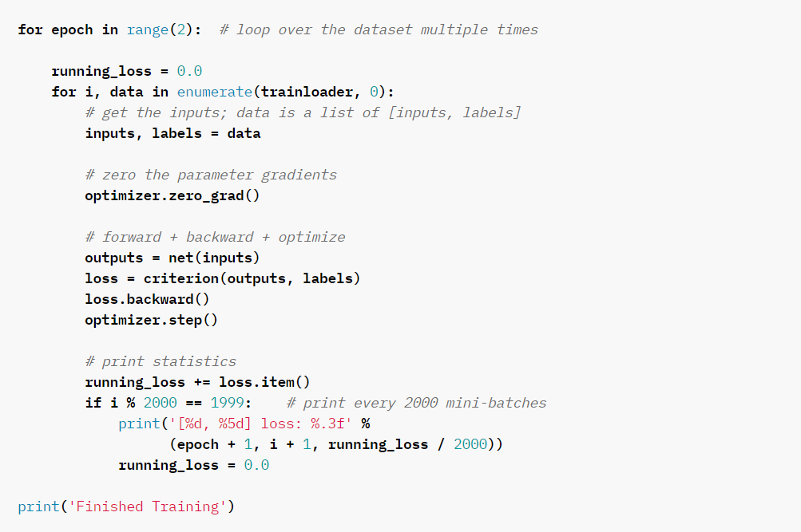
PyTorch

Slide 39
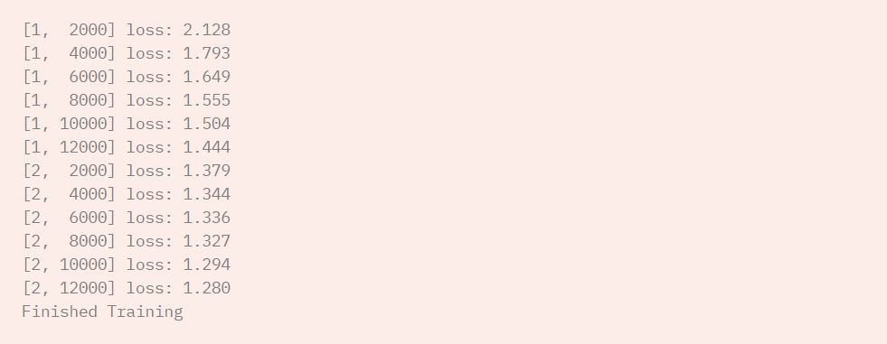
PyTorch

Slide 40
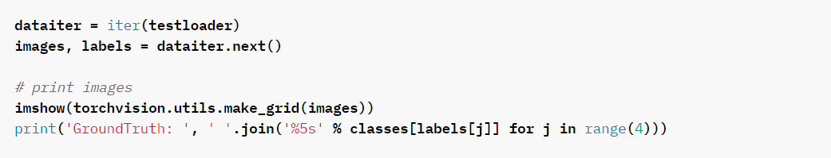
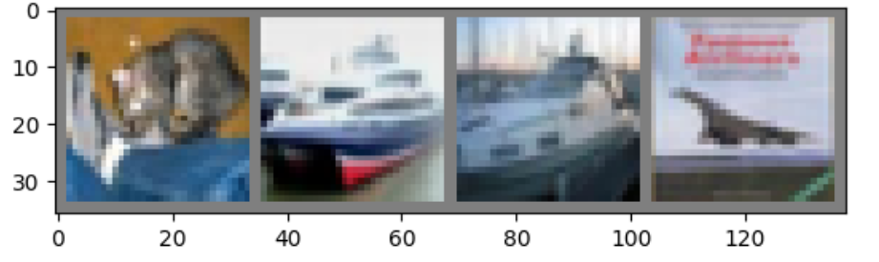
PyTorch

Slide 41
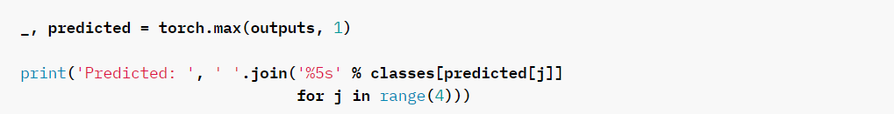
PyTorch

Slide 42
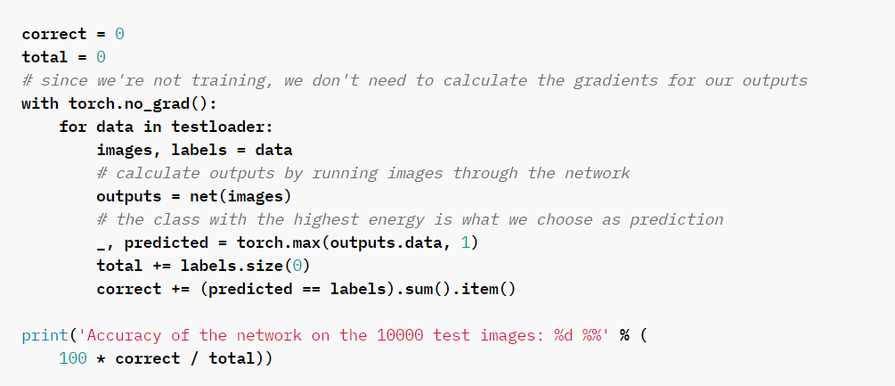
PyTorch

Slide 43
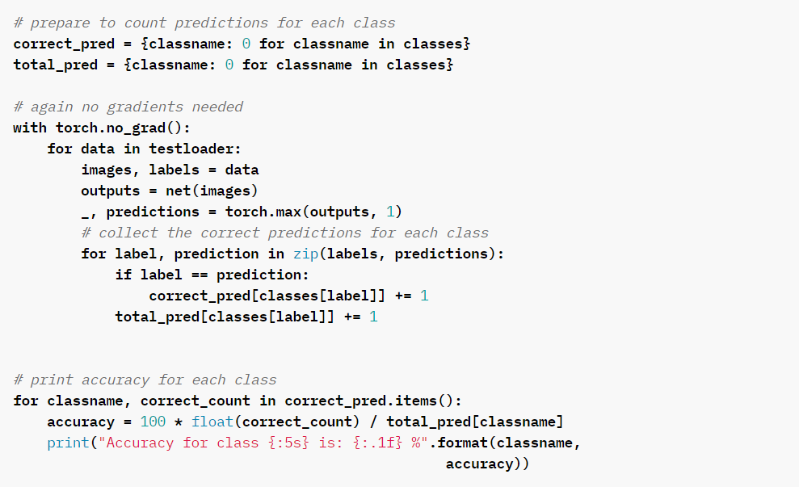
PyTorch

Slide 44
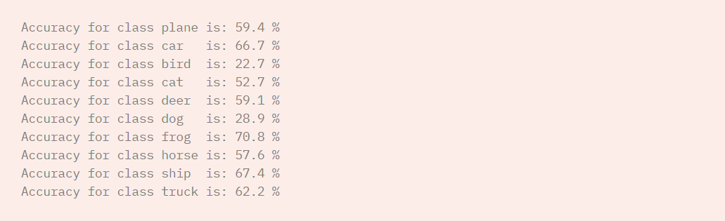
PyTorch

Slide 45
Thanks for attention :)

